Slide 1
Top IT Jobs in the Future
Abramova Polina Alexandrovna

Slide 2

Introduction
My objective today is to discuss the most in-demand IT careers that will shape our digital world.

Slide 3
Structure of the Presentation
Emerging IT roles
Key skills needed
Why these jobs matter

Slide 4
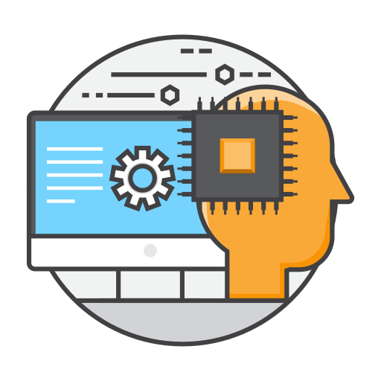
AI & Machine Learning Engineer
Develops artificial intelligence systems and trains machine learning models to solve complex tasks (e.g., speech recognition, self-driving cars).

Slide 5


Cybersecurity Expert
Protects computer systems, networks, and data from cyberattacks and hacking.

Slide 6

Data Scientist
Analyzes large amounts of data to find patterns and help businesses make better decisions.

Slide 7

Cloud Computing Specialist
Works with cloud platforms (like AWS, Google Cloud) to store, manage, and process data remotely.

Slide 8

Quantum Computing Researcher
Explores quantum computers, which can solve problems much faster than traditional computers (e.g., in medicine, cryptography).

Slide 9
Key Skills Needed
Programming (Python, Java)
Data Analysis
Cybersecurity Knowledge
AI & Machine Learning Basics
Problem-Solving

Slide 10
Why These Jobs Matter
They drive innovation.
They protect digital systems.
They help businesses grow.

Slide 11
Conclusion
Today I talked about IT professions of the future. Now answer my questions

Slide 12
Test
AI & Machine Learning Engineers only work on robots
Cybersecurity Experts protect data from hackers
Quantum Computers are already faster than regular computers at all tasks.

